Slide 1
Linear Potentiometers for Structural Engineering
CEE 398
Ping Gu
University of Illinois

Slide 2
Outline:
Introduction
Principle
Features
wound-wire Pot and thin-film Pot
Comparison with LVDT
Examples

Slide 3
Introduction:
Name: Linear Potentiometers (Pot)
Usage: Measure displacement
instruments for Displacement Measurements:
  Optical:
    Laser tracker
    Video camera and digital computer motion analysis
  Mechanical: the most commonly used is dial gage
    individual readings by eye
    0.025~0.0025mm division
    6.25~150mm range
  Acoustic: ultrasonic sound wave
  Electrical: (Displacement transducers; Continuous recording)
    resistive: potentiometers
    inductive: LVDT;VIP sensors
    capacitive:

Slide 4
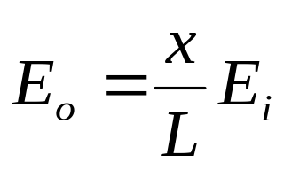
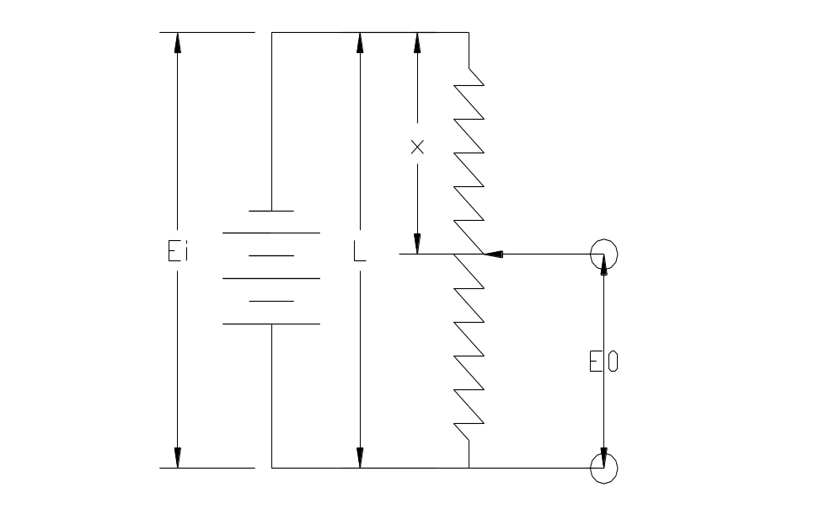
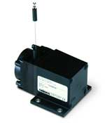
Principle:
Constant input Ei @ends of fixed resistance
Movable slider (wiper) contacting the resistor
Straight wire resistors are not feasible. Resistance of a short length is too low, requires excessive power on voltage source.
Based on the resistor material, POT can be classified into two types: wound-wire Pot and thin-film Pot.

Slide 5
Features:
stroke: up to 1.5 meters
resistance range 10~1,000,000 Ohms.
the signal conditioning equipment much have high input impedance
inertia and friction limit freqency response, precludes its use for dynamic testing.
contact wears rapidly in continuous service. Wiper made of precious metal.
a change in Ei or the shunting effect of a low resistance in the out put circuit changes the current, becoming nonlinear

Slide 6
wound-wire Pot and thin-film Pot
wound-wire Pot
  resolution: wiper jumps from one wire to another, resolution is limited to L/n (Length of the coil/ number of turns), so it is used to measure large displacements (10mm or more). Common resolution 0.05~1% , with 0.05% by many turns of very fine wire.
  Electronic noise due to the movement of wiper from one wire to another. Cleaning and lubrication of the coil.
  Life is about 1 million cycles
Thin-film Pot (thin films with controlled resistivity)
  high resolution (e.g. conductive plastic films 50-100 ohm/mm resolution 0.001 mm)
  lower noise
  longer life (>10 million cycles). (e.g. conductive plastic films 100 million cycles)

Slide 7
Comparison with LVDT:
Disadvantages:
  can only be used for static or quasi-static measurements due to friction and inertia
  resolution
  reliability problem
On the other side, LVDT
  frictionless measurement; non-contact
  suitable for dynamic testing
  infinite resolution
  long life
Advantages:
  simplicity of operation
  inexpensive
  accurate

Slide 8
Example One:
this one: Celesco PT1DC
stroke:2 inches (in this serials 2~50 inches)
input Ei=14.5~40 V DC
output signal 0~10V DC
plastic-hybrid precision pot
resolution essentially infinite
measuring cable 0.019 in diameter (0.48 mm)
cycle life 2.5X10⁶
output signal about 4000 ohms, output impedance 1000 ohms, max. output load 5000 ohms

Slide 9
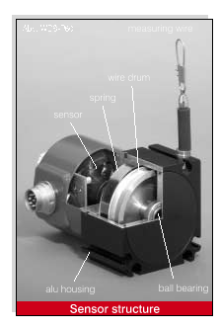
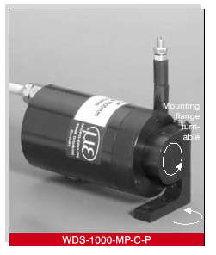
Example Two:

Slide 10
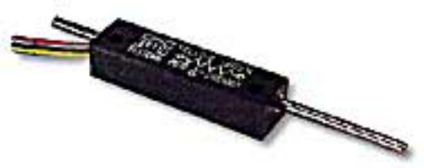
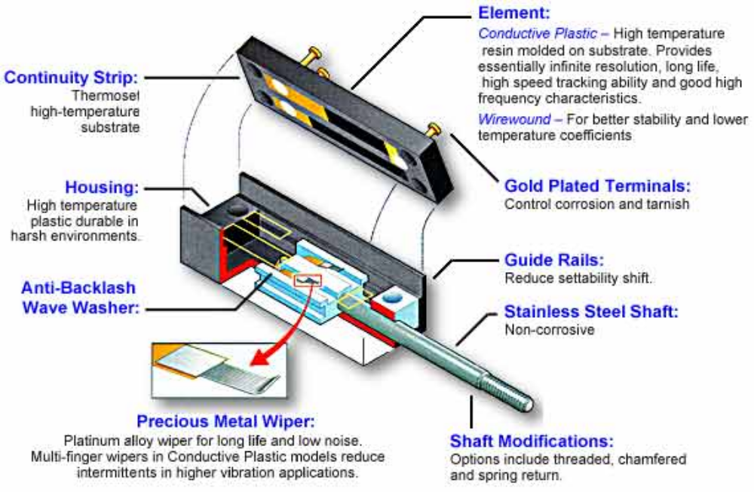
Example Three:

Slide 11
Conclusion:
Introduction
Principle
Features
wound-wire Pot and thin-film Pot
Comparison with LVDT
Examples

